Slide 1
Bike Sharing Demand Analysis Project

Slide 2
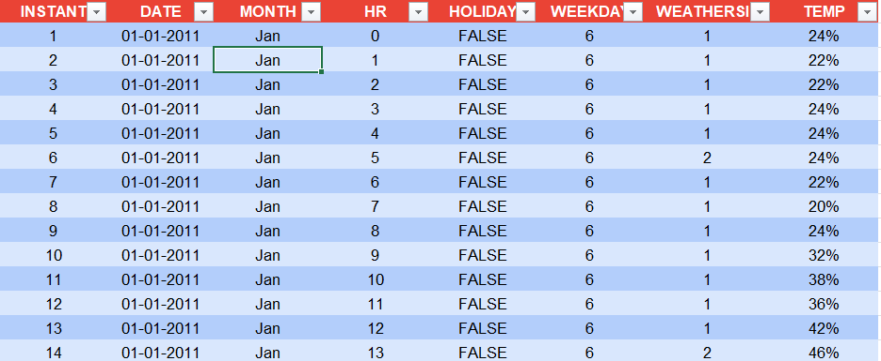
REMOVE DUPLICATES AND ADD REQUIRED COLUMNED STANDARDIZE FORMATS Dataset_1
In the first data sheet, I added a new column labeled “Month” to clearly identify the month name for each record.
To generate the month name, I used the following Excel formula: =TEXT(B3, "mmm")

Slide 3
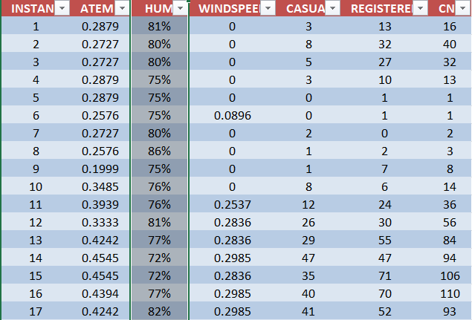
Dataset_2

Slide 4
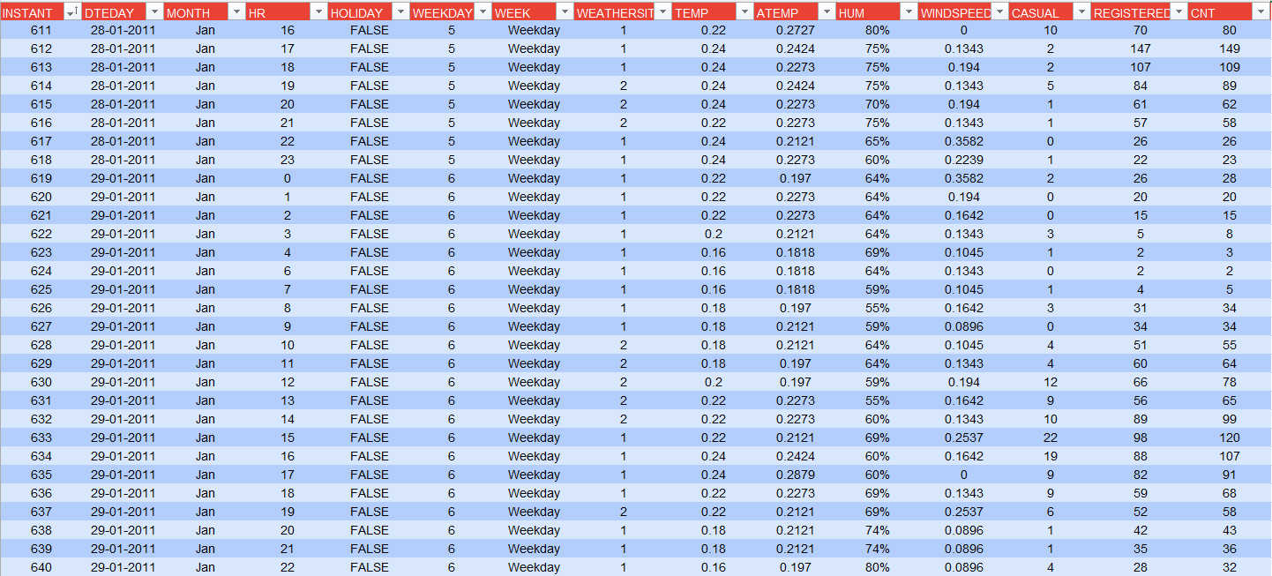
Dataset_2
In third data sheet, I added a new column labeled “week” to clearly identify the weekdays and weekends name for each record.
To generate the week name, I used the following Excel formula: =IF(WEEKDAY([@WEEKDAY],2)>5,"Weekend","Weekday")

Slide 5
Merge 1st and 2nd data sheet
Process Steps
Open Excel and Load All Sheets
Ensure all the sheets you want to merge are within the same workbook.
Each sheet should have identical column headers (same order and names).
Use the Power Query Tool
Go to the Data tab → click Get Data → From Other Sources → Blank Query.
In the Power Query Editor, choose Home → Merge Queries → Merge Queries as New.
Select the sheets you want to merge and click OK.
Verify and Clean Data
Check for duplicate rows, null values, or mismatched columns.
Use Remove Duplicates or Replace Errors to clean up the combined data.
Load Merged Data into Excel
Click Close & Load in Power Query to load the merged table into a new sheet.
Rename the sheet (e.g., Merge 1&2) for clarity.

Slide 7
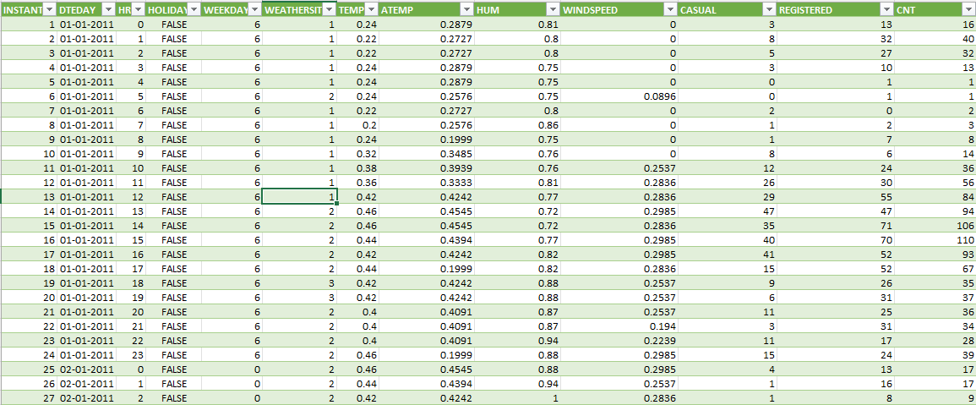
NEW DATASET
Merge 1&2

Slide 8
Merge 1 Data and data sheet 3 merge

Slide 9
Open the Merged File
Open your existing merged Excel workbook (e.g., murge 1&2. or dataset_3).
Make sure the merged sheet has proper column headers and clean data.
Load New Data into Excel
If your new data is in another Excel file:
Go to Data → Get Data → From Workbook → browse and import the new file.
If it’s in a new sheet within the same file, ensure the column structure matches the merged sheet exactly.
Use Power Query to Append Data
Go to Data → Get Data → Launch Power Query Editor.
In the Queries Pane, select your merged query (the one you used to combine sheets).
Choose Home → Append Queries → Append Queries as New.
Select your existing merged query and the new data query → click OK.
Verify the Appended Data
Check that all columns align properly and that no extra or missing columns exist.
Use Transform → Remove Duplicates if necessary.
Load Updated Data
Click Home → Close & Load to refresh your merged dataset.
The appended data will now appear in your merged sheet.

Slide 10
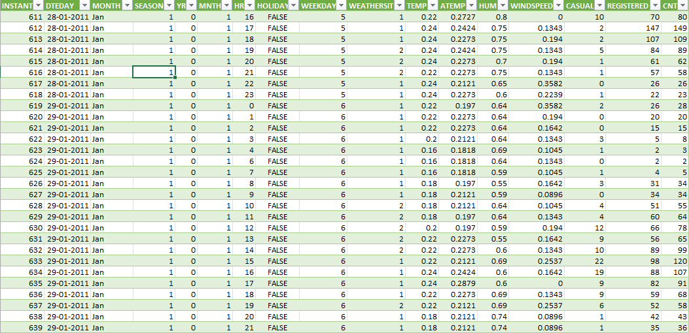
Remove unnecessary column and arrange properly

Slide 11
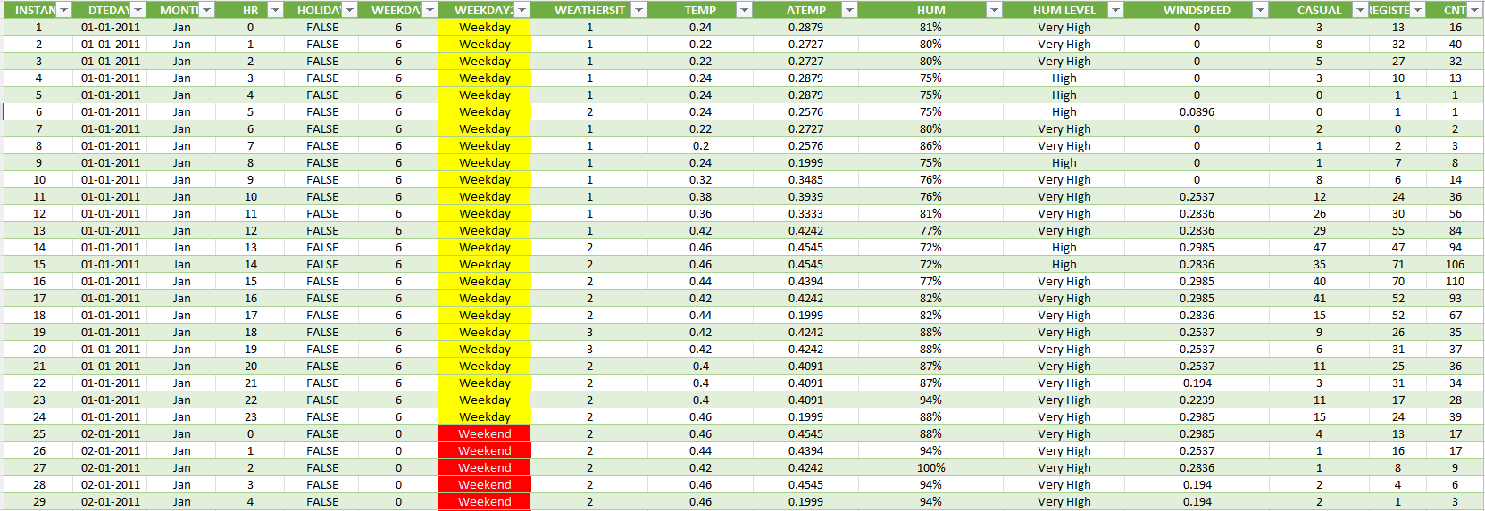
Final Dataset

Slide 12
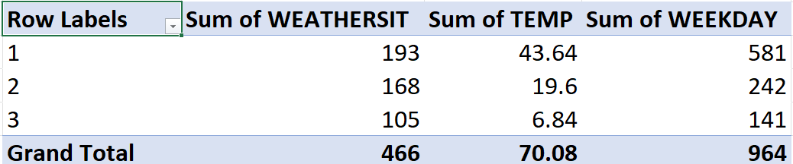
TEMP AND WHETHER
In this pivot table, I used the ‘TEMP’ and ‘Weekdays’ columns from my dataset.
The pivot table summarizes the total temperature values for each day of the week,
allowing a clear comparison of how temperature varies across different weekdays.

Slide 13
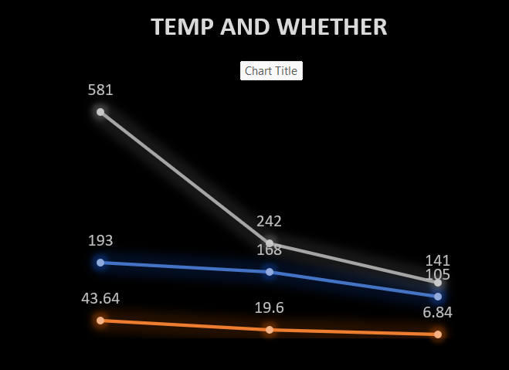

Slide 14
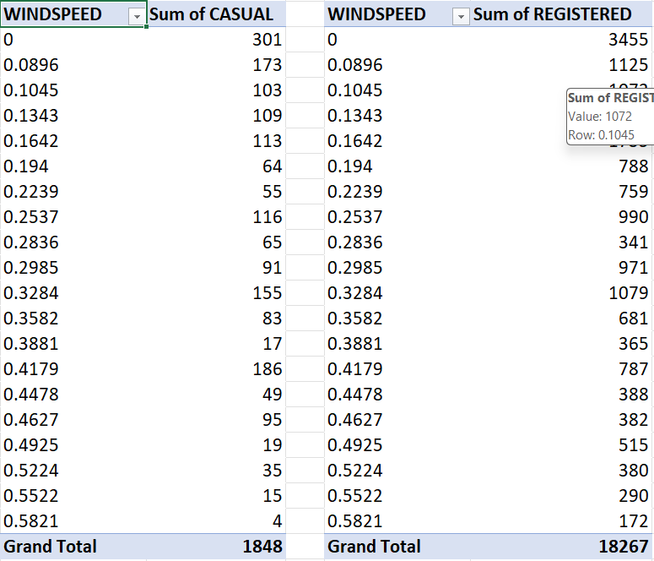
Casual and registered users by windspeed
In this pivot table, I used the ‘CASUAL USERS’ and ‘REGISTERED
USERS’ columns. This table shows how windspeed affects the
number of both types of users.

Slide 15
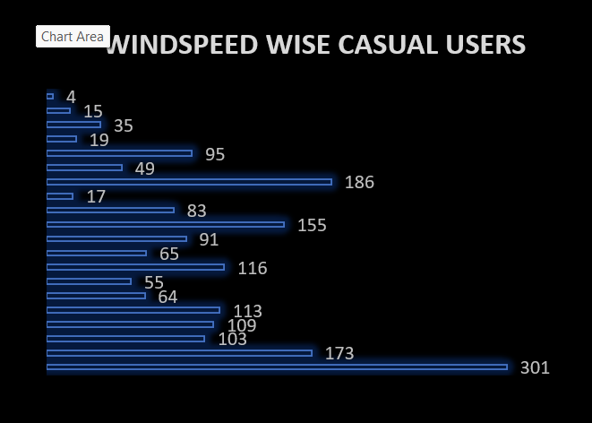
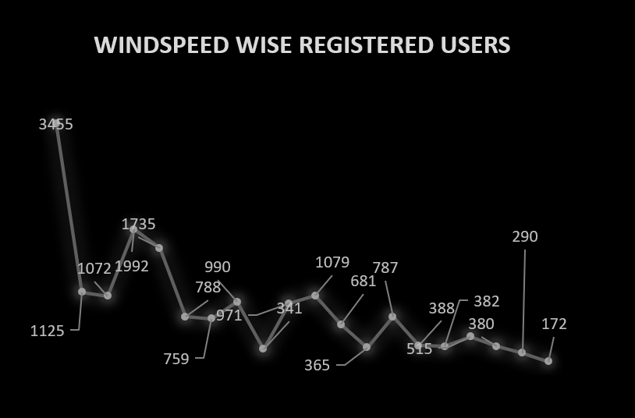

Slide 16
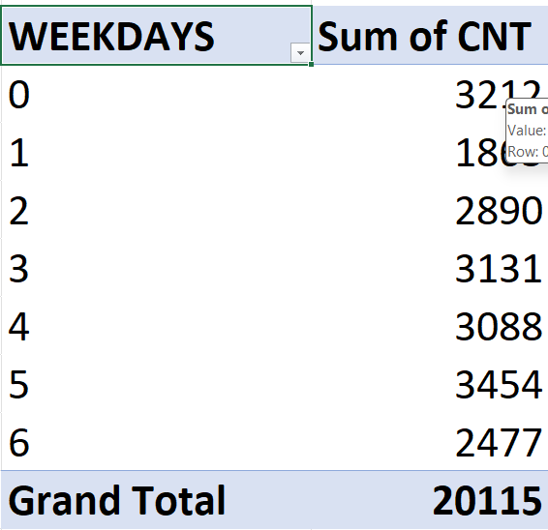
WEEKDAY WISE COUNT
In this pivot table, I used the ‘COUNT’ column from the dataset
to summarize user activity. The table displays the total number of
users for each weekday, allowing us to identify patterns and trends
in user engagement throughout the week. This helps in understanding
which days have higher or lower user activity and can guide decisions
related to resource allocation or targeted actions.

Slide 17
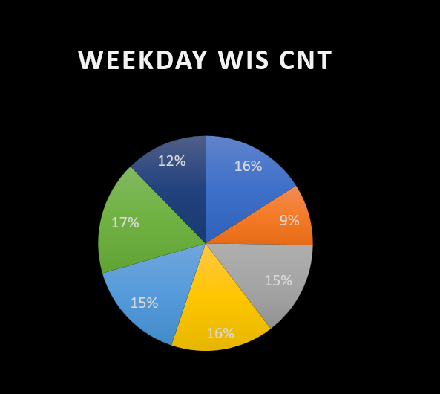

Slide 18
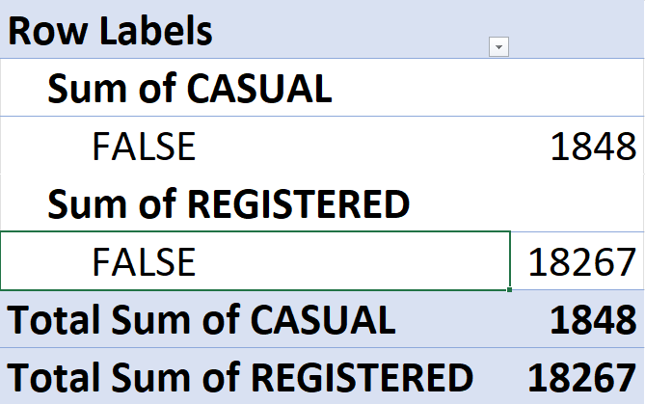
HOLIDAY WISE USER COUNT
In this pivot table, I used the ‘Casual’ and ‘Registered’ user columns. The table displays the total number of users on weekdays and weekends, allowing us to compare usage patterns between different types of users across the week.

Slide 19
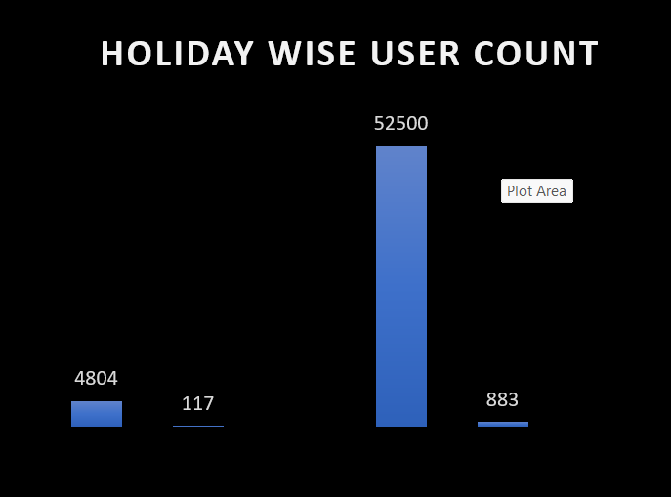

Slide 20
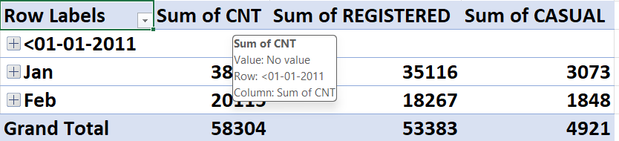
MONTH WISE CNT/REGITERED/CASUAL
In this pivot table, I used the ‘Casual’, ‘Registered’, and ‘Total Count’ columns. The table shows the total number of users on a monthly basis, providing a clear view of user distribution month-wise for both casual and registered users.

Slide 21
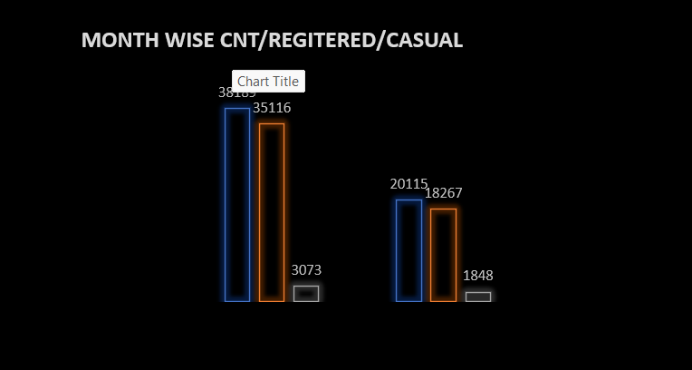

Slide 22
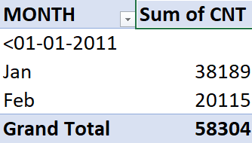
MONTH WISE USER COUNT
In this pivot table, I used the ‘Total Count’ column. The table displays the total number of users on a monthly basis, providing insights into user trends over time.

Slide 23
